Slide 1




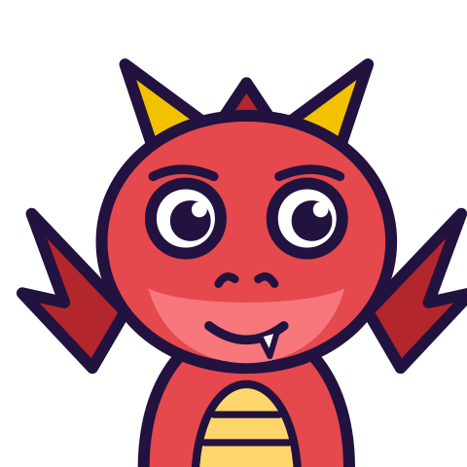

MATH WITH MR DJ
GRADE 5 · NUMBER & OPERATIONS — FRACTIONS
DIVIDING WITH UNIT FRACTIONS
Today's goal: I can divide unit fractions by whole numbers and whole numbers by unit fractions.
Tan
Digit
Blaze
Pi
Notes:
[0:00] Teach this with the “Multiplication as scaling” sheet (Grade 5), not after it. That bank says multiplying does not always enlarge; this one says dividing does not always shrink. Same evidence problem, opposite direction, and a child who has met only one of the two still has half a wrong rule.

Slide 2

WARM-UP
Turn & talk · 1 min
Ask it in words
1
How many halves fit in 6?
TURN & TALK
Two per whole, six wholes. Twelve.
Math With Mr DJ · mathwithmrdj.com · 2/12
Notes:
[0:30] Ask the words BEFORE any notation, every single time. “How many halves fit in 6” gets a confident 12 from a class that would answer 3 to the symbols.

Slide 3

BIG IDEA 1
Write it down
Nobody finds that strange
1
The words are easy. The symbols are not.
2
6 ÷ ½ = 12.
REMEMBER
The strangeness is in the notation, not the maths.
Math With Mr DJ · mathwithmrdj.com · 3/12
Notes:
[1:10] THE slide, and it is worth being explicit: the maths was never the difficulty. The class answered correctly a moment ago in words. What the symbols do is hide the question, so the fix is to restore the question.

Slide 4

BIG IDEA 2
Why 3 feels right
1
“Divide by a half” sounds like “halve it”.
2
And dividing has always made things smaller.
REMEMBER
Every divisor you have used was bigger than 1.
Math With Mr DJ · mathwithmrdj.com · 4/12
Notes:
[2:00] Concede both reasons. “Divide by a half” really does sound like “halve”, and every divisor they have used has been above 1. Neither is carelessness.

Slide 5
BIG IDEA 3
Check it backwards
1
12 halves = 6. Correct.
2
3 halves = 1½. Not 6.
REMEMBER
Multiply back. It settles it.
Math With Mr DJ · mathwithmrdj.com · 5/12
Notes:
[2:50] Multiply back, as in the “Dividing by two-digit divisors” sheet (Grade 5). 12 halves is 6; 3 halves is one and a half. The check is independent of the method that produced the answer, which is what makes it a check.

Slide 6
BIG IDEA 4
The OTHER question
1
½ ÷ 6: a half shared between six.
2
Cut a half into 6 → twelfths.
REMEMBER
1/12. Same numbers. Very different question.
Math With Mr DJ · mathwithmrdj.com · 6/12
Notes:
[3:40] Now the other direction, and do the cutting: a half cut into six pieces. Each is a twelfth, because twelve of them make a whole. This is the “A fraction as division” sheet (Grade 5)’s sharing again.

Slide 7

BIG IDEA 5
Which question is it?
1
How many fit? → answer is BIGGER.
2
How much each? → answer is SMALLER.
REMEMBER
12 or 1/12. Size tells you which.
Math With Mr DJ · mathwithmrdj.com · 7/12
Notes:
[4:50] The pair on one slide, which is the point of the lesson. Same two numbers, 12 and 1/12. Have the class say which question each answers, and note that the SIZE gives it away without any working.

Slide 8

SPOT THE SLIP!
Turn & talk
Something went wrong here…
THE PROBLEM
Work out ½ ÷ 5
WHAT A STUDENT DID
Answered 10 — the opposite question's answer. Reading the division aloud as “a half shared between five” makes 10 plainly absurd.
YOUR MISSION
What went wrong? What’s the right answer?
Math With Mr DJ · mathwithmrdj.com · 8/12
Notes:
Show the problem and the slip. Pairs: what went wrong, and what is the right answer? Take two answers before moving on.

Slide 9
WATCH MR DJ SOLVE
Copy the steps
Work out ½ ÷ 5
1
A half cut into five gives tenths — 1/10.
2
Smaller than the half started with.
3
Check: five tenths make a half.
Answer:
1/10
Math With Mr DJ · mathwithmrdj.com · 9/12
Notes:
Solve it together, one step at a time. It is also the worked example at the top of the practice sheet, so students can look back at it.

Slide 10
YOUR TURN
Whiteboards up!
Pick your pepper!
MILD
MEDIUM
SPICY
Work out 3 ÷ ¼
A 4-metre plank is cut into half-metre pieces. How many pieces? Multiply back to check.
A child answers ½ ÷ 6 = 12. Show that this is impossible without doing the division.
#1 on your practice sheet
#6 on your practice sheet
#9 on your practice sheet
Math With Mr DJ · mathwithmrdj.com · 10/12
Notes:
[6:00] Both directions plus a real context. Insist on the words first — a child who writes the notation first will divide by 4 and not notice. Exit ticket after. Whiteboards: everyone tries Mild, then climbs. These are #1, #6, #9 on the practice sheet.

Slide 11


QUICK CHECK-IN
Show me your fingers
How’s it going?
3 · Got it!
2 · Almost
1 · Not yet
I could teach it
One more example, please
I need some help
Math With Mr DJ · mathwithmrdj.com · 11/12
Notes:
Fingers up: 3 = got it, 2 = almost, 1 = not yet. Pull the 1s for a quick reteach while everyone else starts the practice sheet.

Slide 12

MATH WITH MR DJ
NOW YOU!
Practice sheet: everyone does Mild & Medium, then climb the peppers.
Stuck? Look back at Mr DJ’s example at the top of the sheet.
Need it again? Watch “Dividing With Fractions: Step By Step Guide” on YouTube @MathWithMrDJ
Brain break: 3 new daily puzzles at puzzles.mathwithmrdj.com
Notes:
Launch the practice sheet. Exit ticket in the last 5–8 minutes.

