Slide 1


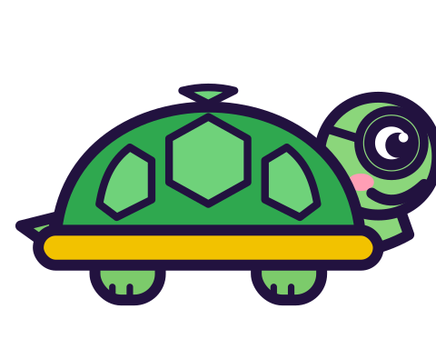
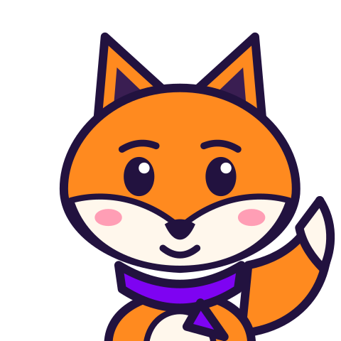
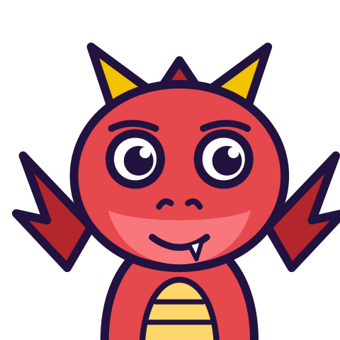

MATH WITH MR DJ
GRADE 5 · NUMBER & OPERATIONS — FRACTIONS
MULTIPLICATION AS SCALING
Today's goal: I can interpret multiplication as scaling (resizing).
Tan
Digit
Blaze
Pi
Notes:
[0:00] Teach this bank BEFORE or alongside the “Decimal arithmetic” sheet (Grade 5), the “Multiplying fractions” sheet (Grade 5) and the “Dividing with unit fractions” sheet (Grade 5). The belief it targets is what makes children reject correct answers in all three, and a child who has “fixed” a right answer to look bigger has learned the wrong lesson from getting it right.

Slide 2

WARM-UP
Turn & talk · 1 min
Why you believed it
1
8 × 2 = 16. 8 × 3 = 24. 8 × 10 = 80.
2
Every multiplication you have ever done.
TURN & TALK
The belief fits all of your evidence.
Math With Mr DJ · mathwithmrdj.com · 2/11
Notes:
[0:40] Concede the belief properly and at length. List multiplications that DO make things bigger and say plainly: this is a correct summary of every multiplication you have met. Nothing here is about carelessness, and children who feel accused stop thinking.

Slide 3

BIG IDEA 1
Write it down
Multiply by exactly 1
1
8 × 1 = 8.
REMEMBER
Unchanged. So 1 is the dividing line.
Math With Mr DJ · mathwithmrdj.com · 3/11
Notes:
[1:30] Multiplying by exactly 1 is the hinge, and it is the one case children accept instantly. 1 is the dividing line — not 0, which is the other guess.

Slide 4

BIG IDEA 2
And 4/4 is 1
1
8 × 4/4 = 8.
2
3/4 is LESS than 4/4.
REMEMBER
So 8 × 3/4 is less than 8. No multiplying needed.
Math With Mr DJ · mathwithmrdj.com · 4/11
Notes:
[2:10] THE slide, and it is the standard's own argument. 4/4 IS 1, so multiplying by it changes nothing; 3/4 is less than 4/4, so multiplying by it must give less. Watch for the moment children realise no arithmetic happened.

Slide 5
BIG IDEA 3
Above and below the line
1
Multiplier more than 1 → bigger.
2
Multiplier exactly 1 → the same.
3
Multiplier less than 1 → smaller.
REMEMBER
Look at the MULTIPLIER. Never calculate.
Math With Mr DJ · mathwithmrdj.com · 5/11
Notes:
[3:10] The three cases on the board, to stay there for the rest of the term. The instruction “never calculate” is not laziness — the judgement is what CHECKS a calculation, so it has to be independent of it.

Slide 6
BIG IDEA 4
Bigger than WHICH?
1
2/3 × 6 = 4.
2
Bigger than 2/3. Smaller than 6.
REMEMBER
The OTHER factor decides. Always ask: than which?
Math With Mr DJ · mathwithmrdj.com · 6/11
Notes:
[4:10] The question children get wrong even after accepting everything above: bigger than WHICH? 2/3 × 6 is bigger than 2/3 and smaller than 6, and both are true. Insist on naming the reference number every time.

Slide 7

BIG IDEA 5
Dividing can make things bigger
1
6 × ½ = 3.
2
6 ÷ ½ = 12.
REMEMBER
How many halves in 6? Twelve of them.
Math With Mr DJ · mathwithmrdj.com · 7/11
Notes:
[5:20] Division, as the mirror image. Ask it as “how many halves fit in 6” and the 12 stops being surprising. the “Dividing with unit fractions” sheet (Grade 5) is the full lesson.

Slide 8
BIG IDEA 6
Remember
1
Multiplier more than 1 → bigger.
2
Exactly 1 → unchanged.
3
Less than 1 → smaller.
Math With Mr DJ · mathwithmrdj.com · 8/11

Slide 9
YOUR TURN
Whiteboards up!
Pick your pepper!
MILD
MEDIUM
SPICY
Without calculating, say whether each is more or less than 12: 12 × 2/3, 12 × 5/5, 12 × 7/6, 12 × 1/10.
Without calculating, put these in order, smallest first: 20 × 1/2, 20 × 1, 20 × 3/4, 20 × 2.
A 12 cm photo is scaled by 3/4, then the result is scaled by 4/3. What size is it now? Explain without doing both multiplications.
#1 on your practice sheet
#2 on your practice sheet
#6 on your practice sheet
Math With Mr DJ · mathwithmrdj.com · 9/11
Notes:
[6:30] Both prompts forbid calculating. If a child calculates and then compares, they have answered a different question — say so gently and ask again. Exit ticket after. Whiteboards: everyone tries Mild, then climbs. These are #1, #2, #6 on the practice sheet.

Slide 10


QUICK CHECK-IN
Show me your fingers
How’s it going?
3 · Got it!
2 · Almost
1 · Not yet
I could teach it
One more example, please
I need some help
Math With Mr DJ · mathwithmrdj.com · 10/11
Notes:
Fingers up: 3 = got it, 2 = almost, 1 = not yet. Pull the 1s for a quick reteach while everyone else starts the practice sheet.

Slide 11

MATH WITH MR DJ
NOW YOU!
Practice sheet: everyone does Mild & Medium, then climb the peppers.
Stuck? Look back at Mr DJ’s example at the top of the sheet.
Need it again? Watch “Multiplying Fractions Step by Step” on YouTube @MathWithMrDJ
Brain break: 3 new daily puzzles at puzzles.mathwithmrdj.com
Notes:
Launch the practice sheet. Exit ticket in the last 5–8 minutes.

