Slide 1


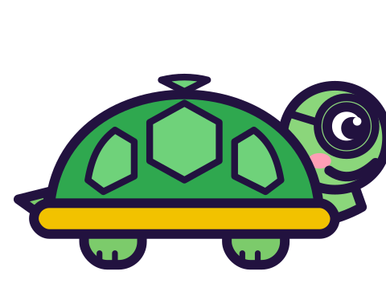

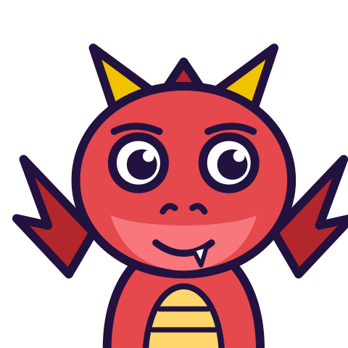

MATH WITH MR DJ
GRADE 5 · NUMBER & OPERATIONS — FRACTIONS
MULTIPLYING FRACTIONS
Today's goal: I can multiply a fraction or whole number by a fraction and solve real-world problems involving multiplication of fractions and mixed numbers.
Tan
Digit
Blaze
Pi
Notes:
[0:00] Say the headline in the first minute: the common-denominator rule is for adding and does not belong here. Children who have just mastered the “Adding and subtracting unlike denominators” sheet (Grade 5) are the ones at risk, so framing this as a WHICH-RULE lesson rather than a new procedure is the point.

Slide 2

WARM-UP
Turn & talk · 1 min
The interference
1
2/3 × 1/4. Convert to twelfths: 8/12 and 3/12.
2
Multiply tops, keep the bottom: 24/12.
TURN & TALK
2. From two numbers under one.
Math With Mr DJ · mathwithmrdj.com · 2/12
Notes:
[0:40] Do the wrong method in full and get 2. Do not correct it yet. Two numbers under one produced an answer of 2, and the class should feel that before hearing why.

Slide 3

BIG IDEA 1
Write it down
Check first
1
Both numbers are less than 1.
2
So the answer is less than both.
REMEMBER
Under 1/4. So under 0.25. Not 2.
Math With Mr DJ · mathwithmrdj.com · 3/12
Notes:
[1:30] The check, borrowed from the “Multiplication as scaling” sheet (Grade 5) a lesson early because it is needed here: multiplying by less than one makes things smaller, so the answer is under both factors. That rejects 2 with no method at all.

Slide 4
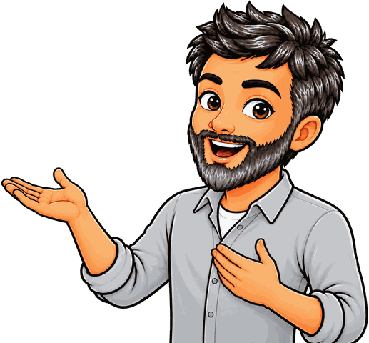
BIG IDEA 2
× means “of”
1
2/3 × 1/4 is a QUARTER OF two thirds.
2
Take 2/3. Cut it into 4. Keep one piece.
REMEMBER
2/12 = 1/6.
Math With Mr DJ · mathwithmrdj.com · 4/12
Notes:
[2:20] THE slide. Read × as “of” and do the cutting: two thirds, cut into four, keep one. A bar model or folded paper strip makes this concrete in seconds.

Slide 5
BIG IDEA 3
Where the 12 comes from
1
A third cut into four is a TWELFTH.
2
The new unit is made by the cutting.
REMEMBER
So the bottoms multiply. 3 × 4 = 12.
Math With Mr DJ · mathwithmrdj.com · 5/12
Notes:
[3:20] Where the twelfths came from, and this is the reason the bottoms multiply. The new unit is MADE by the cutting — nobody agreed it in advance, which is precisely the difference from adding.

Slide 6
BIG IDEA 4
A fraction of a whole
1
2/3 of 12. Divide by 3: that is 4.
2
Now take TWO of them.
REMEMBER
8. Dividing was step one of two.
Math With Mr DJ · mathwithmrdj.com · 6/12
Notes:
[4:20] A fraction of a whole number. The child who answers 4 has done the first of two steps, so say that: divide by the bottom, then multiply by the top. Not a wrong method — an unfinished one.

Slide 7

BIG IDEA 5
Mixed numbers: use improper
1
2½ × 1½ = 5/2 × 3/2 = 15/4 = 3¾.
2
Part by part gives 2¼ — two pieces missing.
REMEMBER
2 × ½ and 1 × ½. That is the 1½.
Math With Mr DJ · mathwithmrdj.com · 7/12
Notes:
[5:20] Mixed numbers. Convert to improper fractions and the difficulty disappears. Show the part-by-part answer and name the two missing pieces — this is the distributive law, and the same omission loses two terms of a bracket in algebra.

Slide 8

SPOT THE SLIP!
Turn & talk
Something went wrong here…
THE PROBLEM
Work out 3/4 × 2/5
WHAT A STUDENT DID
Answered 6/20 unsimplified, or added the fractions instead. 3/10 is less than both 3/4 and 2/5, which is the size check.
YOUR MISSION
What went wrong? What’s the right answer?
Math With Mr DJ · mathwithmrdj.com · 8/12
Notes:
Show the problem and the slip. Pairs: what went wrong, and what is the right answer? Take two answers before moving on.

Slide 9
WATCH MR DJ SOLVE
Copy the steps
Work out 3/4 × 2/5
1
3/4 × 2/5 = 6/20, which simplifies to 3/10.
2
Smaller than both factors.
3
This is the one where cancelling first is quicker: the 2 and the 4 share a factor.
Answer:
3/10
Math With Mr DJ · mathwithmrdj.com · 9/12
Notes:
Solve it together, one step at a time. It is also the worked example at the top of the practice sheet, so students can look back at it.

Slide 10
YOUR TURN
Whiteboards up!
Pick your pepper!
MILD
MEDIUM
SPICY
Work out 1/2 × 1/3
Work out 2½ × 1½
Explain why 1/2 × 1/3 gives sixths, when neither fraction is a sixth.
#1 on your practice sheet
#4 on your practice sheet
#8 on your practice sheet
Math With Mr DJ · mathwithmrdj.com · 10/12
Notes:
[6:45] Three products, with the bigger-or-smaller judgement first each time. Exit ticket after. Whiteboards: everyone tries Mild, then climbs. These are #1, #4, #8 on the practice sheet.

Slide 11


QUICK CHECK-IN
Show me your fingers
How’s it going?
3 · Got it!
2 · Almost
1 · Not yet
I could teach it
One more example, please
I need some help
Math With Mr DJ · mathwithmrdj.com · 11/12
Notes:
Fingers up: 3 = got it, 2 = almost, 1 = not yet. Pull the 1s for a quick reteach while everyone else starts the practice sheet.

Slide 12

MATH WITH MR DJ
NOW YOU!
Practice sheet: everyone does Mild & Medium, then climb the peppers.
Stuck? Look back at Mr DJ’s example at the top of the sheet.
Need it again? Watch “Multiplying Fractions Step by Step” on YouTube @MathWithMrDJ
Brain break: 3 new daily puzzles at puzzles.mathwithmrdj.com
Notes:
Launch the practice sheet. Exit ticket in the last 5–8 minutes.

