Slide 1




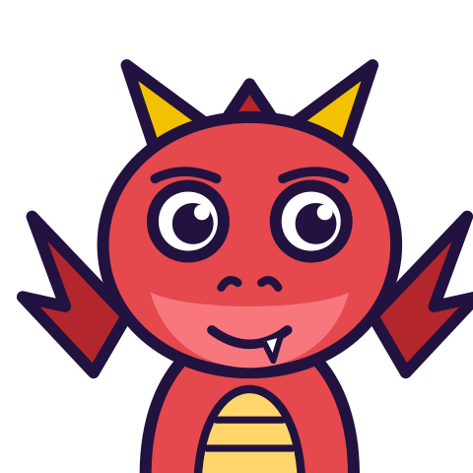

MATH WITH MR DJ
GRADE 5 · OPERATIONS & ALGEBRAIC THINKING
RELATING TWO NUMBER PATTERNS
Today's goal: I can generate two numerical patterns and identify relationships between them.
Tan
Digit
Blaze
Pi
Notes:
[0:00] The question this lesson answers is narrow and worth stating: not how each pattern grows, but how the two compare AT THE SAME POSITION. Children answer the first question when asked the second more often than anything else here.

Slide 2

WARM-UP
Turn & talk · 1 min
Generate both
1
Add 3 from 0: 0, 3, 6, 9, 12.
2
Add 9 from 0: 0, 9, 18, 27, 36.
TURN & TALK
Now line them up in pairs.
Math With Mr DJ · mathwithmrdj.com · 2/11
Notes:
[0:45] Generate both on the board in two rows, vertically aligned, so corresponding terms sit above one another. The alignment does real work — a horizontal list invites comparing neighbours within a row.

Slide 3

BIG IDEA 1
Write it down
The tempting answer
1
3 and 9. That is 6 more.
2
So the second pattern is 6 more than the first?
REMEMBER
Check the NEXT pair. 6 and 18.
Math With Mr DJ · mathwithmrdj.com · 3/11
Notes:
[1:30] Ask for the relationship and expect “6 more”. Do not correct it. Write it down as a claim to be tested, then move to the next pair — the child should be the one who finds it fails.

Slide 4

BIG IDEA 2
It was true once
1
Gaps: 0, 6, 12, 18, 24.
2
Only ONE pair differs by 6.
REMEMBER
One pair cannot tell you a rule.
Math With Mr DJ · mathwithmrdj.com · 4/11
Notes:
[2:30] THE slide. The gaps written out are the whole argument: 0, 6, 12, 18, 24. Name the general lesson explicitly, because it is the thread this belongs to — one pair of numbers can never distinguish “6 more” from “3 times”, so a rule checked once is not checked.

Slide 5
BIG IDEA 3
What is true every time
1
9 = 3 × 3. 18 = 3 × 6. 36 = 3 × 12.
REMEMBER
Three times. And 3 is 9 ÷ 3 — the steps.
Math With Mr DJ · mathwithmrdj.com · 5/11
Notes:
[3:30] The multiplicative answer, and then the part worth the extra minute: the multiplier IS the ratio of the two step sizes, 9 ÷ 3. That is why it holds for every pair rather than by luck.

Slide 6
BIG IDEA 4
Ordered pairs
1
(0,0), (3,9), (6,18), (9,27), (12,36).
2
Right 3, up 9. Right 3, up 9.
REMEMBER
A straight line through the origin.
Math With Mr DJ · mathwithmrdj.com · 6/11
Notes:
[4:30] Ordered pairs, and say aloud that the first coordinate comes from the first pattern. Plot them if there is time — the straight line through the origin is the picture of “three times”, and the “The coordinate plane” sheet (Grade 5) is where the plotting itself is taught.

Slide 7

BIG IDEA 5
The zero was doing work
1
Start both at 1: 1, 4, 7, 10, 13 and 1, 10, 19, 28, 37.
2
Is 10 three times 4?
REMEMBER
No. “Three times” needed the 0.
Math With Mr DJ · mathwithmrdj.com · 7/11
Notes:
[5:45] The honest slide, and it is often skipped. Every textbook example starts at 0, which makes the clean “three times” look like a general truth. Start at 1 and it breaks. Children should know the 0 was a condition, not decoration.

Slide 8
BIG IDEA 6
Remember
1
Compare corresponding terms, not neighbours.
2
Say it as a multiplier, and the multiplier is the ratio of the two step sizes.
3
A difference that grows means the relationship is not a difference.
Math With Mr DJ · mathwithmrdj.com · 8/11

Slide 9
YOUR TURN
Whiteboards up!
Pick your pepper!
MILD
MEDIUM
SPICY
Write the first five terms of “start at 0, add 2” and of “start at 0, add 8”.
The 10th term of “start at 0, add 3” is 27. Find the 10th term of “start at 0, add 9” without writing out the pattern.
For “add 3” and “add 9” from 0, write the difference between each pair of corresponding terms. What does a growing difference tell you?
#1 on your practice sheet
#4 on your practice sheet
#6 on your practice sheet
Math With Mr DJ · mathwithmrdj.com · 9/11
Notes:
[7:00] The add-2 / add-8 pair, with the instruction to test on two pairs rather than one. Exit ticket after. Whiteboards: everyone tries Mild, then climbs. These are #1, #4, #6 on the practice sheet.

Slide 10


QUICK CHECK-IN
Show me your fingers
How’s it going?
3 · Got it!
2 · Almost
1 · Not yet
I could teach it
One more example, please
I need some help
Math With Mr DJ · mathwithmrdj.com · 10/11
Notes:
Fingers up: 3 = got it, 2 = almost, 1 = not yet. Pull the 1s for a quick reteach while everyone else starts the practice sheet.

Slide 11

MATH WITH MR DJ
NOW YOU!
Practice sheet: everyone does Mild & Medium, then climb the peppers.
Stuck? Look back at Mr DJ’s example at the top of the sheet.
Need it again? Step-by-step videos on YouTube @MathWithMrDJ
Brain break: 3 new daily puzzles at puzzles.mathwithmrdj.com
Notes:
Launch the practice sheet. Exit ticket in the last 5–8 minutes.

