Slide 1


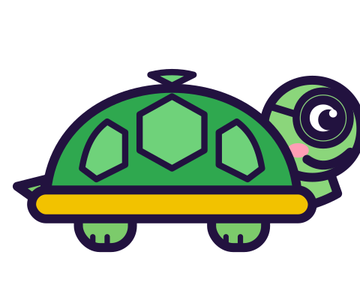

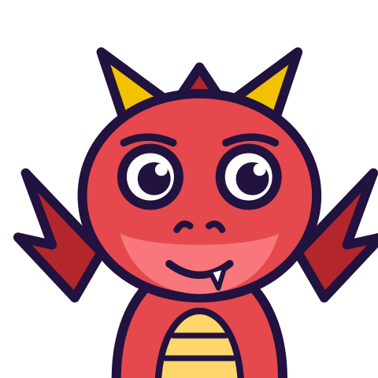

MATH WITH MR DJ
GRADE 5 · NUMBER & OPERATIONS IN BASE TEN
ROUNDING DECIMALS
Today's goal: I can use place-value understanding to round decimals to any place.
Tan
Digit
Blaze
Pi
Notes:
[0:00] This continues the “Rounding multi-digit numbers” sheet (Grade 4) rather than starting fresh — the neighbours-and-midpoint method is the same, and children who met it in Grade 4 should be reminded rather than retaught. The new content is what happens when the shortcut is applied more than once.

Slide 2

WARM-UP
Turn & talk · 1 min
The question rounding asks
1
Which two tenths is it between?
2
Which one is it nearer?
TURN & TALK
Name the two candidates FIRST.
Math With Mr DJ · mathwithmrdj.com · 2/12
Notes:
[0:40] Write the two questions on the board and keep them there all lesson. Every item on both sheets can be answered by them, and a child who writes the two candidates down cannot make the staging error.

Slide 3

BIG IDEA 1
Write it down
3.548 to the nearest tenth
1
Between 3.5 and 3.6.
2
Midpoint 3.55. Is 3.548 past it?
REMEMBER
No. So 3.5.
Math With Mr DJ · mathwithmrdj.com · 3/12
Notes:
[1:20] Work 3.548 with the method. The midpoint 3.55 is the only number that has to be worked out, and comparing against it is one decision.

Slide 4

BIG IDEA 2
The tempting method
1
3.548 → 3.55 (nearest hundredth)
2
3.55 → 3.6 (nearest tenth)
REMEMBER
Both steps correct. Answer wrong.
Math With Mr DJ · mathwithmrdj.com · 4/12
Notes:
[2:15] THE slide. Present the staged method sympathetically and check both steps aloud — they really are both right. The class should be uneasy rather than corrected: two correct steps, and a different answer.

Slide 5
BIG IDEA 3
Why staging breaks it
1
The 8 in the thousandths should never be consulted.
2
Staging lets it push the 4 up to a 5.
REMEMBER
Always round the ORIGINAL number. Once.
Math With Mr DJ · mathwithmrdj.com · 5/12
Notes:
[3:15] The explanation, and it is worth being precise: rounding to the nearest tenth is a question about which tenth, so the thousandths digit has no vote. Staging gives it one by letting it change the hundredths first. Say “always go back to the original number” and have them write it down.

Slide 6
BIG IDEA 4
Keep the place you rounded to
1
0.96 to the nearest tenth is 1.0.
2
Not 1.
REMEMBER
The 0 says “this is tenths”.
Math With Mr DJ · mathwithmrdj.com · 6/12
Notes:
[4:15] The 1.0 case. Ask what is lost by writing 1: the answer to “how many tenths” should be readable as tenths, and 1.0 says ten of them.

Slide 7

BIG IDEA 5
Exactly halfway
1
12.5 is as near to 12 as to 13.
2
We round up. Because we agreed to.
REMEMBER
A convention, not a fact about nearness.
Math With Mr DJ · mathwithmrdj.com · 7/12
Notes:
[5:15] The honest slide. 12.5 is exactly between, so “nearest” does not decide it — we agreed to round up. Children are usually told 12.5 IS nearer 13, which is simply untrue, and they can tell.

Slide 8
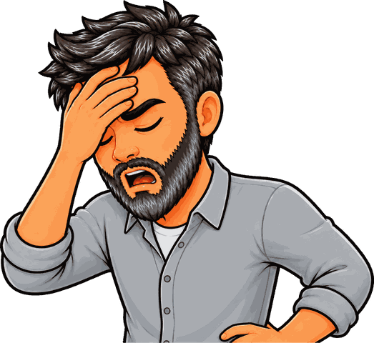
SPOT THE SLIP!
Turn & talk
Something went wrong here…
THE PROBLEM
Round to the nearest whole number: 8.5, 0.49, 19.62.
WHAT A STUDENT DID
Answered 1 for 0.49, rounding up because the digits after the point “look big”. 0.49 is less than a half, so it rounds to 0 — and 0 is a legitimate answer to a rounding question.
YOUR MISSION
What went wrong? What’s the right answer?
Math With Mr DJ · mathwithmrdj.com · 8/12
Notes:
Show the problem and the slip. Pairs: what went wrong, and what is the right answer? Take two answers before moving on.

Slide 9
WATCH MR DJ SOLVE
Copy the steps
Round to the nearest whole number: 8.5, 0.49, 19.62.
1
8.5 is exactly halfway between 8 and 9 — up by agreement, 9.
2
0.49 is between 0 and 1, midpoint 0.5, below it — 0.
3
19.62 is between 19 and 20, midpoint 19.5, past it — 20.
Answer:
9, 0 and 20
Math With Mr DJ · mathwithmrdj.com · 9/12
Notes:
Solve it together, one step at a time. It is also the worked example at the top of the practice sheet, so students can look back at it.

Slide 10
YOUR TURN
Whiteboards up!
Pick your pepper!
MILD
MEDIUM
SPICY
Round to the nearest tenth: 2.47, 0.83, 5.05.
A shelf is 1.96 m long. Round it to the nearest tenth of a metre, and write the answer with its unit.
Round 0.749 to the nearest tenth. Then round 0.741 to the nearest tenth. Should they be the same?
#1 on your practice sheet
#3 on your practice sheet
#5 on your practice sheet
Math With Mr DJ · mathwithmrdj.com · 10/12
Notes:
[6:30] The three-places task is the one to press on: same number, three different correct answers, each rounded from the original. Exit ticket after. Whiteboards: everyone tries Mild, then climbs. These are #1, #3, #5 on the practice sheet.

Slide 11


QUICK CHECK-IN
Show me your fingers
How’s it going?
3 · Got it!
2 · Almost
1 · Not yet
I could teach it
One more example, please
I need some help
Math With Mr DJ · mathwithmrdj.com · 11/12
Notes:
Fingers up: 3 = got it, 2 = almost, 1 = not yet. Pull the 1s for a quick reteach while everyone else starts the practice sheet.

Slide 12

MATH WITH MR DJ
NOW YOU!
Practice sheet: everyone does Mild & Medium, then climb the peppers.
Stuck? Look back at Mr DJ’s example at the top of the sheet.
Need it again? Watch “How to Write Decimals in Word Form (Place Value, Expanded Form & Rounding)” on YouTube @MathWithMrDJ
Brain break: 3 new daily puzzles at puzzles.mathwithmrdj.com
Notes:
Launch the practice sheet. Exit ticket in the last 5–8 minutes.

