Slide 1


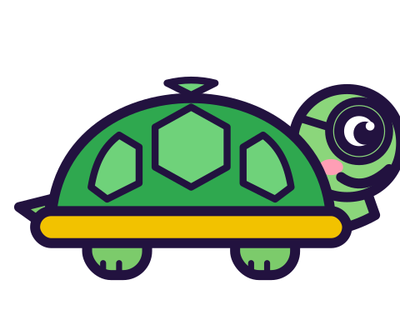

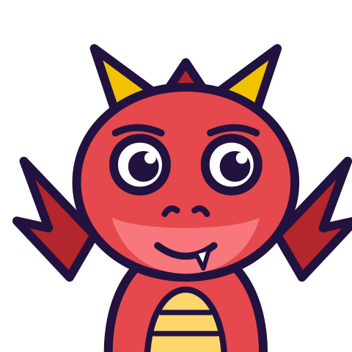

MATH WITH MR DJ
GRADE 5 · MEASUREMENT & DATA
VOLUME AND CUBIC UNITS
Today's goal: I can recognize volume as an attribute of solid figures; understand cubic units and measure volumes by counting unit cubes.
Tan
Digit
Blaze
Pi
Notes:
[0:00] Build the solids with real cubes if you have them. The hidden-cube problem is obvious with blocks in hand and almost invisible on paper, and the whole lesson is about the difference between those two.

Slide 2

WARM-UP
Turn & talk · 1 min
One unit cube
1
A cube 1 unit on every side.
2
Its volume is ONE cubic unit.
TURN & TALK
Volume is how many of those fill a solid.
Math With Mr DJ · mathwithmrdj.com · 2/12
Notes:
[0:40] Define the unit cube properly — 1 unit on every side, volume one cubic unit. Volume then needs no formula at all: it is a COUNT.

Slide 3

BIG IDEA 1
Write it down
No gaps
1
Packed tight, no spaces between.
2
Cubes with gaps do not measure anything.
REMEMBER
Same rule as tiling a rectangle.
Math With Mr DJ · mathwithmrdj.com · 3/12
Notes:
[1:15] “No gaps” is in the standard, and it is an earlier lesson tiling rule in three dimensions. A loose pile of cubes in a box does not measure the box.

Slide 4

BIG IDEA 2
Count what you see
1
A 3 × 3 × 3 drawing shows at most 19 cubes.
2
Careful counting of the outside gives 26.
REMEMBER
One cube is hidden from every direction.
Math With Mr DJ · mathwithmrdj.com · 4/12
Notes:
[1:50] Draw the 3 × 3 × 3 and ask for a count. Expect 9, 19 and 26 — and take 26 seriously, because it is a careful and complete count of the outside.

Slide 5
BIG IDEA 3
It is still there
1
A flat picture cannot show an inside.
2
The drawing is not the solid.
REMEMBER
27. Do not count the picture.
Math With Mr DJ · mathwithmrdj.com · 5/12
Notes:
[2:40] THE slide. A flat picture cannot show an inside, so the drawing is not the solid. Break a built cube open, or take the top layer off, to show the middle cube existing.

Slide 6
BIG IDEA 4
Count by LAYERS
1
One layer: 3 × 3 = 9 cubes.
2
Three layers.
REMEMBER
27. Nothing needs to be visible.
Math With Mr DJ · mathwithmrdj.com · 6/12
Notes:
[3:30] Layers, which is the real fix: 3 × 3 then three of them. Nothing needs to be seen, so the drawing's limitation stops mattering. This also sets up the “Volume by multiplication” sheet (Grade 5) without handing over the formula.

Slide 7

WATCH OUT!
Volume is not surface
1
2 × 2 × 2: volume 8 cubic units.
2
Its skin is 24 unit squares.
DON’T FALL FOR IT
Inside, or skin. Two questions.
Math With Mr DJ · mathwithmrdj.com · 7/12
Notes:
[4:30] Volume against surface, briefly but explicitly — children conflate them and both are counts of unit things. Inside or skin.

Slide 8

SPOT THE SLIP!
Turn & talk
Something went wrong here…
THE PROBLEM
Find the volume by counting layers: a 5 × 2 × 3 prism.
WHAT A STUDENT DID
Added the dimensions: 5 + 2 + 3 = 10 — which happens to equal ONE layer here, so the answer looks plausible. That coincidence is why the check is to picture the block.
YOUR MISSION
What went wrong? What’s the right answer?
Math With Mr DJ · mathwithmrdj.com · 8/12
Notes:
Show the problem and the slip. Pairs: what went wrong, and what is the right answer? Take two answers before moving on.

Slide 9
WATCH MR DJ SOLVE
Copy the steps
Find the volume by counting layers: a 5 × 2 × 3 prism.
1
The base layer is 5 × 2 = 10 cubes.
2
Three layers, so 30 cubic units.
Answer:
30 cubic units
Math With Mr DJ · mathwithmrdj.com · 9/12
Notes:
Solve it together, one step at a time. It is also the worked example at the top of the practice sheet, so students can look back at it.

Slide 10
YOUR TURN
Whiteboards up!
Pick your pepper!
MILD
MEDIUM
SPICY
Find the volume by counting layers: a 4 × 3 × 2 prism.
Two solids are 6 × 2 × 2 and 4 × 3 × 2. Which holds more cubes?
How many cubes are completely hidden in a 4 × 4 × 4? What shape do the hidden cubes make?
#1 on your practice sheet
#5 on your practice sheet
#6 on your practice sheet
Math With Mr DJ · mathwithmrdj.com · 10/12
Notes:
[5:45] The 4 × 4 × 4 hidden-cube question is the good one: eight hidden cubes, forming a 2 × 2 × 2 in the middle. Exit ticket after. Whiteboards: everyone tries Mild, then climbs. These are #1, #5, #6 on the practice sheet.

Slide 11


QUICK CHECK-IN
Show me your fingers
How’s it going?
3 · Got it!
2 · Almost
1 · Not yet
I could teach it
One more example, please
I need some help
Math With Mr DJ · mathwithmrdj.com · 11/12
Notes:
Fingers up: 3 = got it, 2 = almost, 1 = not yet. Pull the 1s for a quick reteach while everyone else starts the practice sheet.

Slide 12

MATH WITH MR DJ
NOW YOU!
Practice sheet: everyone does Mild & Medium, then climb the peppers.
Stuck? Look back at Mr DJ’s example at the top of the sheet.
Need it again? Step-by-step videos on YouTube @MathWithMrDJ
Brain break: 3 new daily puzzles at puzzles.mathwithmrdj.com
Notes:
Launch the practice sheet. Exit ticket in the last 5–8 minutes.

