Slide 1


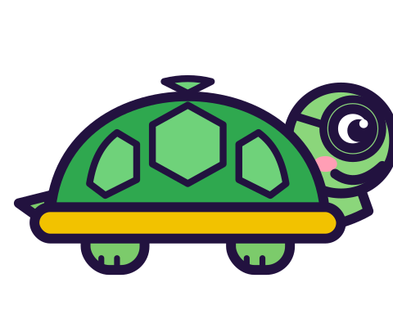

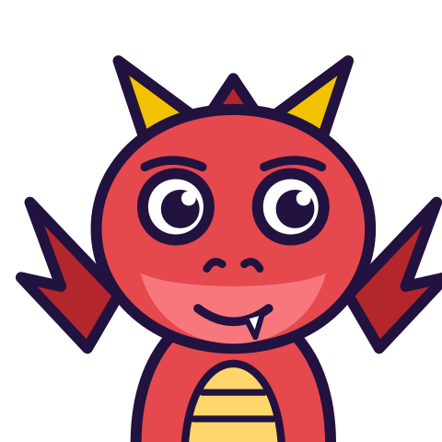

MATH WITH MR DJ
GRADE 5 · MEASUREMENT & DATA
VOLUME BY MULTIPLICATION
Today's goal: I can relate volume to multiplication and addition; solve real-world problems.
Tan
Digit
Blaze
Pi
Notes:
[0:00] Do not introduce l × w × h as a rule. Every child will already know it, and knowing it is exactly the problem this lesson addresses — it is the three-dimensional version of length-times-width before any tiling (an earlier lesson).

Slide 2

WARM-UP
Turn & talk · 1 min
You already count layers
1
4 × 3 × 2. One layer: 4 × 3 = 12 cubes.
2
Two layers.
TURN & TALK
24 cubic units. You did this yesterday.
Math With Mr DJ · mathwithmrdj.com · 2/12
Notes:
[0:35] Start from the “Volume and cubic units” sheet (Grade 5)’s layer counting, which they did last lesson. Nothing new is being taught yet, and that should be obvious to them.

Slide 3

BIG IDEA 1
Write it down
That IS the formula
1
4 × 3 is the AREA OF THE BASE.
2
2 is the NUMBER OF LAYERS.
REMEMBER
l × w × h = (base) × (layers).
Math With Mr DJ · mathwithmrdj.com · 3/12
Notes:
[1:15] THE slide. Name the two parts out loud: 4 × 3 is the area of the BASE, and 2 is the number of LAYERS. Both are things you can point at. The formula is a shortcut for the counting they can already do.

Slide 4

BIG IDEA 2
So why multiply?
1
Because each layer has the same number of cubes.
2
Adding 4 + 3 + 2 = 9 counts nothing.
REMEMBER
9 is fewer than ONE layer.
Math With Mr DJ · mathwithmrdj.com · 4/12
Notes:
[2:10] Answer the question children never ask: why multiply rather than add? Because every layer holds the same number. Then show 4 + 3 + 2 = 9 and note it is smaller than one layer, which nobody with cubes in mind would accept.

Slide 5
BIG IDEA 3
Any face can be the base
1
12 × 2, or 8 × 3, or 6 × 4.
REMEMBER
All 24. A free check, every time.
Math With Mr DJ · mathwithmrdj.com · 5/12
Notes:
[3:00] Any face as the base, and this is a check worth insisting on — it is free, and it catches a mis-multiplication immediately.

Slide 6
BIG IDEA 4
Working backwards
1
Volume 72, height 3. Base area?
2
72 ÷ 3 = 24.
REMEMBER
6 × 4, or 8 × 3, or 12 × 2.
Math With Mr DJ · mathwithmrdj.com · 6/12
Notes:
[3:50] Working backwards, which is what tells you whether a child has the two PARTS or just three numbers. Note the base area is determined and its shape is not.

Slide 7

BIG IDEA 5
An L-shape
1
5 × 4 × 1 slab, 2 × 2 × 3 block on part of it.
2
20 + 12 = 32 cubic units.
REMEMBER
Its box would be 5 × 4 × 4 = 80. Mostly air.
Math With Mr DJ · mathwithmrdj.com · 7/12
Notes:
[4:45] The composite solid, and use an L-SHAPE rather than two blocks end to end — two blocks in a line usually form a box, so multiplying the overall dimensions works there and teaches the wrong habit. Here the overall box is 5 × 4 × 4 = 80 while the solid holds 32, so 48 cubic units of it is air. Split, calculate, add — and check the pieces do not overlap.

Slide 8

SPOT THE SLIP!
Turn & talk
Something went wrong here…
THE PROBLEM
Find the volume of a 6 × 4 × 5 prism.
WHAT A STUDENT DID
Answered 15 — the dimensions added. The gap between 15 and 120 is the clearest illustration that adding is the wrong operation.
YOUR MISSION
What went wrong? What’s the right answer?
Math With Mr DJ · mathwithmrdj.com · 8/12
Notes:
Show the problem and the slip. Pairs: what went wrong, and what is the right answer? Take two answers before moving on.

Slide 9
WATCH MR DJ SOLVE
Copy the steps
Find the volume of a 6 × 4 × 5 prism.
1
6 × 4 = 24 in the base layer.
2
5 layers, so 120 cubic units.
3
Worth noticing this base equals the WHOLE volume of item 1 — the numbers grow fast.
Answer:
120 cubic units
Math With Mr DJ · mathwithmrdj.com · 9/12
Notes:
Solve it together, one step at a time. It is also the worked example at the top of the practice sheet, so students can look back at it.

Slide 10
YOUR TURN
Whiteboards up!
Pick your pepper!
MILD
MEDIUM
SPICY
Find the volume of a 4 × 3 × 2 prism.
For the 4 × 3 × 2 prism, work out the volume three times, using a different face as the base each time.
A 3 × 3 × 3 block sits on a 3 × 3 × 1 slab. Find the total volume, and explain why you must not count the join twice.
#1 on your practice sheet
#3 on your practice sheet
#8 on your practice sheet
Math With Mr DJ · mathwithmrdj.com · 10/12
Notes:
[6:00] Both tasks demand the base area and layer count separately, which is what stops the formula being three empty slots. Exit ticket after. Whiteboards: everyone tries Mild, then climbs. These are #1, #3, #8 on the practice sheet.

Slide 11


QUICK CHECK-IN
Show me your fingers
How’s it going?
3 · Got it!
2 · Almost
1 · Not yet
I could teach it
One more example, please
I need some help
Math With Mr DJ · mathwithmrdj.com · 11/12
Notes:
Fingers up: 3 = got it, 2 = almost, 1 = not yet. Pull the 1s for a quick reteach while everyone else starts the practice sheet.

Slide 12

MATH WITH MR DJ
NOW YOU!
Practice sheet: everyone does Mild & Medium, then climb the peppers.
Stuck? Look back at Mr DJ’s example at the top of the sheet.
Need it again? Step-by-step videos on YouTube @MathWithMrDJ
Brain break: 3 new daily puzzles at puzzles.mathwithmrdj.com
Notes:
Launch the practice sheet. Exit ticket in the last 5–8 minutes.

