Slide 1






MATH WITH MR DJ
GRADE 6 · THE NUMBER SYSTEM
ADDING & SUBTRACTING DECIMALS
Today's goal: I can fluently add multi-digit decimals using the standard algorithm.
Tan
Digit
Blaze
Pi
Notes:
[0:00] Frame the skill: ragged decimals, done right.

Slide 2

WARM-UP
Turn & talk · 1 min
3.5 + 2.75
1
Do it in your head. Don’t say it out loud yet.
TURN & TALK
is it 6.25, or 3.80?
Math With Mr DJ · mathwithmrdj.com · 2/11
Notes:
[1:00] Hook — 6.25 vs 3.80. Do NOT resolve. The wrong answer comes from right-aligning; surface it without naming who said it.

Slide 3

BIG IDEA 1
Write it down
Decimal points line up. Always.
1
Stack so the points are in one vertical line — ignore how long each number is.
2
Fill empty places with 0: 3.5 becomes 3.50. Same number, full columns.
Math With Mr DJ · mathwithmrdj.com · 3/11
Notes:
[3:00] The rule and the reason: aligning points means aligning place value. Zeros are placeholders, not new value.

Slide 4

BIG IDEA 2
3.50 + 2.75 = 6.25
1
Points aligned, hundredths under hundredths, tenths under tenths.
REMEMBER
Right-aligning the digits is the #1 error.
Math With Mr DJ · mathwithmrdj.com · 4/11
Notes:
[5:00] WE1 — resolve the hook. Show the wrong stacking beside the right one so the error is visible, then discard it.

Slide 5
BIG IDEA 3
Whole numbers have a hidden point
1
20 is really 20.00
2
20.00 − 13.47 = 6.53
REMEMBER
Every whole number ends in an invisible .00
Math With Mr DJ · mathwithmrdj.com · 5/11
Notes:
[7:00] WE2 — whole numbers as n.00. This unlocks every money problem ($20 change).

Slide 6
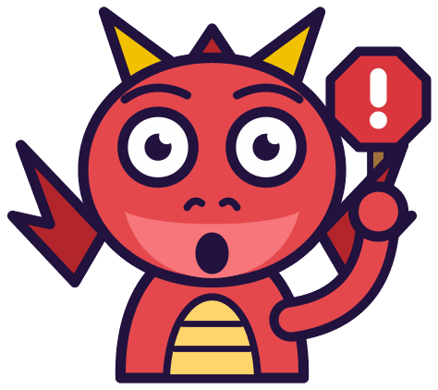
WATCH OUT!
Careful: 5.6 and 5.06 are different
1
5.6 = 5.60 (six tenths)
2
5.06 = five and six hundredths
3
5.60 − 5.06 = 0.54, not 0
DON’T FALL FOR IT
Place value decides the size — not the digits.
Math With Mr DJ · mathwithmrdj.com · 6/11
Notes:
[11:00] The comparison trap: 5.6 vs 5.06. Longer is not bigger. This previews ordering rational numbers.

Slide 7

SPOT THE SLIP!
Turn & talk
Digit found a slip…
THE PROBLEM
Compute 9.3 − 4.17.
WHAT A STUDENT DID
Got 5.27 — subtracted 7 from 0 as if it were 7 from 10 without regrouping the tenths.
YOUR MISSION
What went wrong? What’s the right answer?
Math With Mr DJ · mathwithmrdj.com · 7/11
Notes:
Show the problem and the slip. Pairs: what went wrong, and what is the right answer? Take two answers before moving on.

Slide 8

WATCH MR DJ SOLVE
Copy the steps
Compute 9.3 − 4.17.
1
9.30 − 4.17 = 5.13.
Answer:
5.13
Math With Mr DJ · mathwithmrdj.com · 8/11
Notes:
Solve it together, one step at a time. It is also the worked example at the top of the practice sheet, so students can look back at it.

Slide 9



YOUR TURN
Whiteboards up!
Pick your pepper!
MILD
MEDIUM
SPICY
Compute 6.2 + 3.45.
Compute 100 − 38.64.
A fence is built in three sections: 14.6 m, 9.85 m, and 22.3 m. What is the total length?
#1 on your practice sheet
#3 on your practice sheet
#6 on your practice sheet
Math With Mr DJ · mathwithmrdj.com · 9/11
Notes:
[9:00] CFU — all-student response. Answer 4.54. Watch for 5.46 (subtracted smaller from larger). Whiteboards: everyone tries Mild, then climbs. These are #1, #3, #6 on the practice sheet.

Slide 10

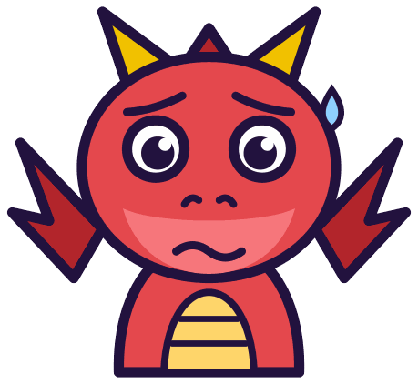

QUICK CHECK-IN
Show me your fingers
How’s it going?
3 · Got it!
2 · Almost
1 · Not yet
I could teach it
One more example, please
I need some help
Math With Mr DJ · mathwithmrdj.com · 10/11
Notes:
Fingers up: 3 = got it, 2 = almost, 1 = not yet. Pull the 1s for a quick reteach while everyone else starts the practice sheet.

Slide 11


MATH WITH MR DJ
NOW YOU!
Practice sheet: everyone does Mild & Medium, then climb the peppers.
Stuck? Look back at Mr DJ’s example at the top of the sheet.
Need it again? Step-by-step videos on YouTube @MathWithMrDJ
Brain break: 3 new daily puzzles at puzzles.mathwithmrdj.com
Notes:
[13:00] Launch the in-class practice sheet. Launch the practice sheet. Exit ticket in the last 5–8 minutes.

