Slide 1



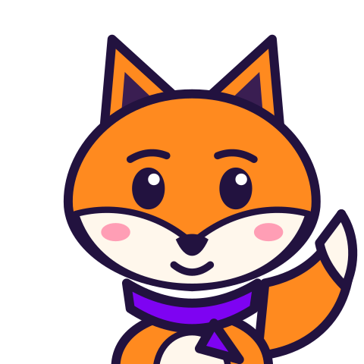
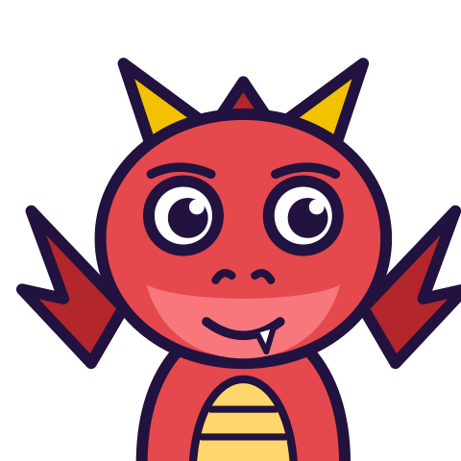

MATH WITH MR DJ
GRADE 6 · THE NUMBER SYSTEM
FACTORING WITH THE DISTRIBUTIVE PROPERTY
Today's goal: I can use the distributive property to express a sum of two whole numbers 1-100 with a common factor as a multiple of a sum of two whole numbers with no common factor.
Tan
Digit
Blaze
Pi
Notes:
[0:00] Frame the skill: this is GCF put to work. Assumes yesterday’s GCF lesson.

Slide 2

WARM-UP
Turn & talk · 1 min
36 + 8
1
Both numbers share something. What?
TURN & TALK
can you rewrite this as a multiplication?
Math With Mr DJ · mathwithmrdj.com · 2/11
Notes:
[1:00] Hook — don’t resolve. Someone will offer 4; ask how they know it’s the biggest.

Slide 3

BIG IDEA 1
Write it down
Pull out the GCF — from BOTH
1
Find the GCF of the two numbers.
2
Divide each number by it. Write GCF( + ).
Math With Mr DJ · mathwithmrdj.com · 3/11
Notes:
[3:00] Name the move: find GCF, divide BOTH, write it as a product. The ‘both’ is where students slip.

Slide 4

BIG IDEA 2
36 + 8 = 4(9 + 2)
1
GCF(36, 8) = 4
2
36 ÷ 4 = 9 · 8 ÷ 4 = 2
3
Check: 4 × 11 = 44 = 36 + 8
REMEMBER
Divide BOTH — not just the first one.
Math With Mr DJ · mathwithmrdj.com · 4/11
Notes:
[5:00] WE1 — resolve the hook. Model the multiply-back check every single time; it should become automatic.

Slide 5

WATCH OUT!
Not finished until nothing is shared
1
24 + 36 = 2(12 + 18) → true, but 12 and 18 still share 6
2
24 + 36 = 12(2 + 3) → 2 and 3 share nothing ✓
DON’T FALL FOR IT
True and fully factored are different things.
Math With Mr DJ · mathwithmrdj.com · 5/11
Notes:
[7:00] WE2 — the key distinction. Show a TRUE but unfinished factoring next to the finished one. This is the #1 misconception.

Slide 6
BIG IDEA 4
Two checks before you stop
1
Multiply back: does it equal the original sum?
2
Do the two numbers inside share any factor? If yes, keep going.
Math With Mr DJ · mathwithmrdj.com · 6/11
Notes:
[11:00] The two stopping checks. A student who runs both can self-assess without the teacher.

Slide 7

SPOT THE SLIP!
Turn & talk
Something went wrong here…
THE PROBLEM
Rewrite 42 + 14 using the GCF.
WHAT A STUDENT DID
Forgot that 14 ÷ 14 = 1 and wrote 14(3 + 14) or 14(3).
YOUR MISSION
What went wrong? What’s the right answer?
Math With Mr DJ · mathwithmrdj.com · 7/11
Notes:
Show the problem and the slip. Pairs: what went wrong, and what is the right answer? Take two answers before moving on.

Slide 8
WATCH MR DJ SOLVE
Copy the steps
Rewrite 42 + 14 using the GCF.
1
GCF = 14
2
42÷14=3, 14÷14=1.
3
Check: 14 × 4 = 56.
Answer:
14(3 + 1)
Math With Mr DJ · mathwithmrdj.com · 8/11
Notes:
Solve it together, one step at a time. It is also the worked example at the top of the practice sheet, so students can look back at it.

Slide 9
YOUR TURN
Whiteboards up!
Pick your pepper!
MILD
MEDIUM
SPICY
Rewrite 15 + 25 using the GCF.
Rewrite 18 + 27 using the GCF.
Rewrite 60 + 48 using the GCF, then check your answer by multiplying back.
#1 on your practice sheet
#3 on your practice sheet
#6 on your practice sheet
Math With Mr DJ · mathwithmrdj.com · 9/11
Notes:
[9:00] CFU — all-student response. Answer 10(2 + 3). Watch for 5(4 + 6). Whiteboards: everyone tries Mild, then climbs. These are #1, #3, #6 on the practice sheet.

Slide 10


QUICK CHECK-IN
Show me your fingers
How’s it going?
3 · Got it!
2 · Almost
1 · Not yet
I could teach it
One more example, please
I need some help
Math With Mr DJ · mathwithmrdj.com · 10/11
Notes:
Fingers up: 3 = got it, 2 = almost, 1 = not yet. Pull the 1s for a quick reteach while everyone else starts the practice sheet.

Slide 11

MATH WITH MR DJ
NOW YOU!
Practice sheet: everyone does Mild & Medium, then climb the peppers.
Stuck? Look back at Mr DJ’s example at the top of the sheet.
Need it again? Step-by-step videos on YouTube @MathWithMrDJ
Brain break: 3 new daily puzzles at puzzles.mathwithmrdj.com
Notes:
[13:00] Launch the in-class practice sheet. Launch the practice sheet. Exit ticket in the last 5–8 minutes.

