Slide 1


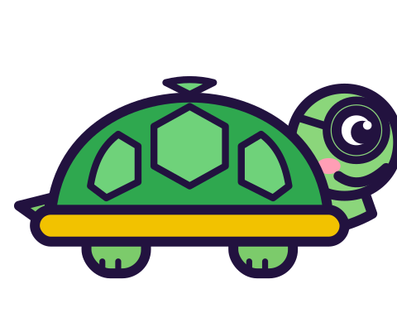



MATH WITH MR DJ
GRADE 7 · STATISTICS & PROBABILITY
DRAWING INFERENCES FROM RANDOM SAMPLES
Today's goal: I can use data from a random sample to draw inferences about a population with an unknown characteristic, generate multiple samples (or simulated samples) of the same size to gauge the variation in estimates, generate multiple samples of categorical data of the same size to gauge the variation in estimates, generate multiple samples (or simulated samples) of the same size of numerical data to gauge the variation in estimates and understand that sample statistics are estimates of population statistics but are not the same.
Tan
Digit
Blaze
Pi
Notes:
[0:00] Frame it: sampling gives you an estimate with uncertainty attached, and both halves matter.

Slide 2

WARM-UP
Turn & talk · 1 min
20 students sampled. 12 own a pet.
1
The school has 500 students. How many own pets?
TURN & TALK
how sure are you of your answer?
Math With Mr DJ · mathwithmrdj.com · 2/11
Notes:
[1:00] Hook — ask for the number AND their confidence. Most give 300 with high confidence, which slide 4 undermines.

Slide 3

BIG IDEA 1
Write it down
Scale up the proportion
1
12 out of 20 = 60%.
2
60% of 500 = 300 students.
Math With Mr DJ · mathwithmrdj.com · 3/11
Notes:
[3:00] The scaling method. Insist on the proportion as an intermediate step; scaling counts directly invites errors.

Slide 4

BIG IDEA 2
Now take four more samples
1
9, 11, 14, 10 — all samples of 20, all taken the same way.
2
Estimates: 225, 275, 350, 250.
REMEMBER
Same method. Estimates 125 students apart.
Math With Mr DJ · mathwithmrdj.com · 4/11
Notes:
[5:00] WE1 — the four extra samples. Let the range 225 to 350 sit visibly before commenting.

Slide 5
BIG IDEA 3
That spread is INFORMATION
1
It tells you how much a single sample of 20 can wander.
2
Without repeating, you'd have a number and no idea how shaky it is.
Math With Mr DJ · mathwithmrdj.com · 5/11
Notes:
[7:30] WE2 — reframe the variation as information rather than as a fault in the method.

Slide 6
BIG IDEA 4
Say it honestly
1
Not: “280 students own pets.”
2
But: “From a sample of 100, we estimate about 280.”
REMEMBER
More data narrows the uncertainty. It never removes it.
Math With Mr DJ · mathwithmrdj.com · 6/11
Notes:
[11:30] The honest sentence. Mark for this wording on the exit ticket; students calibrate to what is marked.

Slide 7

SPOT THE SLIP!
Turn & talk
Something went wrong here…
THE PROBLEM
How many percentage points apart are those two samples?
WHAT A STUDENT DID
Answered 5, the difference in counts rather than percentages.
YOUR MISSION
What went wrong? What’s the right answer?
Math With Mr DJ · mathwithmrdj.com · 7/11
Notes:
Show the problem and the slip. Pairs: what went wrong, and what is the right answer? Take two answers before moving on.

Slide 8
WATCH MR DJ SOLVE
Copy the steps
How many percentage points apart are those two samples?
1
70 − 45 = 25.
Answer:
25 percentage points
Math With Mr DJ · mathwithmrdj.com · 8/11
Notes:
Solve it together, one step at a time. It is also the worked example at the top of the practice sheet, so students can look back at it.

Slide 9
YOUR TURN
Whiteboards up!
Pick your pepper!
MILD
MEDIUM
SPICY
A sample of 20 finds 9 pet owners. What percentage is that?
Use the sample of 9 to estimate the number of pet owners in a school of 500.
How far apart are those two estimates? What does that tell you about trusting a single sample of 20?
#1 on your practice sheet
#3 on your practice sheet
#7 on your practice sheet
Math With Mr DJ · mathwithmrdj.com · 9/11
Notes:
[9:30] CFU — all-student response. 280 students. Watch for students scaling 56 by 500 without dividing by 100. Whiteboards: everyone tries Mild, then climbs. These are #1, #3, #7 on the practice sheet.

Slide 10


QUICK CHECK-IN
Show me your fingers
How’s it going?
3 · Got it!
2 · Almost
1 · Not yet
I could teach it
One more example, please
I need some help
Math With Mr DJ · mathwithmrdj.com · 10/11
Notes:
Fingers up: 3 = got it, 2 = almost, 1 = not yet. Pull the 1s for a quick reteach while everyone else starts the practice sheet.

Slide 11

MATH WITH MR DJ
NOW YOU!
Practice sheet: everyone does Mild & Medium, then climb the peppers.
Stuck? Look back at Mr DJ’s example at the top of the sheet.
Need it again? Step-by-step videos on YouTube @MathWithMrDJ
Brain break: 3 new daily puzzles at puzzles.mathwithmrdj.com
Notes:
[13:30] Launch the in-class practice sheet. Launch the practice sheet. Exit ticket in the last 5–8 minutes.

