Slide 1




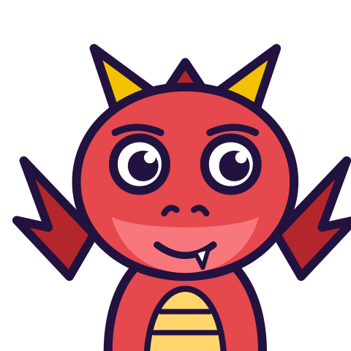

MATH WITH MR DJ
GRADE 7 · THE NUMBER SYSTEM
MULTIPLYING & DIVIDING RATIONAL NUMBERS
Today's goal: I can multiply rational numbers, divide rational numbers and multiply and divide rational numbers.
Tan
Digit
Blaze
Pi
Notes:
[0:00] Frame it: the sign rule is easy. Knowing which operation it applies to is the lesson.

Slide 2

WARM-UP
Turn & talk · 1 min
Two problems, same numbers
1
−6 × (−4) = ?
2
−6 + (−4) = ?
TURN & TALK
same answer, or different?
Math With Mr DJ · mathwithmrdj.com · 2/10
Notes:
[1:00] Hook — poll same or different. Do NOT resolve. Many students will say the same, which is exactly the misconception.

Slide 3

BIG IDEA 1
Write it down
Multiplying & dividing
1
Same signs → POSITIVE.
2
Different signs → NEGATIVE.
3
Division follows the same rule — it is multiplying by the reciprocal.
Math With Mr DJ · mathwithmrdj.com · 3/10
Notes:
[3:00] State the rule for multiplying and dividing. Note that division inherits it via the reciprocal, so it is one rule, not two.

Slide 4

BIG IDEA 2
24 and −10
1
−6 × (−4) = 24. −6 + (−4) = −10.
REMEMBER
“Two negatives make a positive” is about MULTIPLYING. Not adding.
Math With Mr DJ · mathwithmrdj.com · 4/10
Notes:
[5:00] WE1 — resolve the hook. Put both answers side by side and leave them up for the rest of the lesson.

Slide 5
BIG IDEA 3
Why they differ
1
Multiplying by a negative REVERSES direction. Reverse twice → forwards.
2
Adding a negative just keeps moving left.
REMEMBER
Owing $6 four times over is a bigger debt, not a credit.
Math With Mr DJ · mathwithmrdj.com · 5/10
Notes:
[7:00] WE2 — the reason. The debt sentence does more work than the direction language for most students; use whichever lands.

Slide 6
BIG IDEA 4
Count the negatives
1
EVEN count → positive. They pair off and cancel.
2
ODD count → negative. One is left unpaired.
REMEMBER
(−2)(−3)(−4) = −24. Three is odd.
Math With Mr DJ · mathwithmrdj.com · 6/10
Notes:
[11:30] The counting rule. Derive it from pairing rather than announcing it, then test with four factors.

Slide 7

BIG IDEA 5
Remember
1
Multiplying or dividing: same signs → positive, different signs → negative.
2
Adding: the number line decides, and two negatives stay negative.
3
Decide the sign first, then the size — it stops you carrying a sign error through the arithmetic.
Math With Mr DJ · mathwithmrdj.com · 7/10

Slide 8
YOUR TURN
Whiteboards up!
Pick your pepper!
MILD
MEDIUM
SPICY
Find −7 × 3.
Find −36 ÷ 9.
Find (−2) × (−3) × (−4). Then state a rule for the sign of a product from how many negatives it contains.
#1 on your practice sheet
#4 on your practice sheet
#9 on your practice sheet
Math With Mr DJ · mathwithmrdj.com · 8/10
Notes:
[9:30] CFU — all-student response. −4 and 4. Watch for the same sign given twice. Whiteboards: everyone tries Mild, then climbs. These are #1, #4, #9 on the practice sheet.

Slide 9


QUICK CHECK-IN
Show me your fingers
How’s it going?
3 · Got it!
2 · Almost
1 · Not yet
I could teach it
One more example, please
I need some help
Math With Mr DJ · mathwithmrdj.com · 9/10
Notes:
Fingers up: 3 = got it, 2 = almost, 1 = not yet. Pull the 1s for a quick reteach while everyone else starts the practice sheet.

Slide 10

MATH WITH MR DJ
NOW YOU!
Practice sheet: everyone does Mild & Medium, then climb the peppers.
Stuck? Look back at Mr DJ’s example at the top of the sheet.
Need it again? Step-by-step videos on YouTube @MathWithMrDJ
Brain break: 3 new daily puzzles at puzzles.mathwithmrdj.com
Notes:
[13:30] Launch the in-class practice sheet. Launch the practice sheet. Exit ticket in the last 5–8 minutes.

