Slide 1


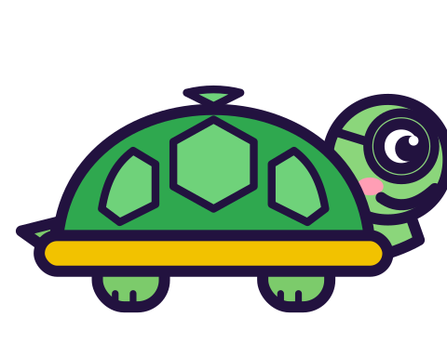
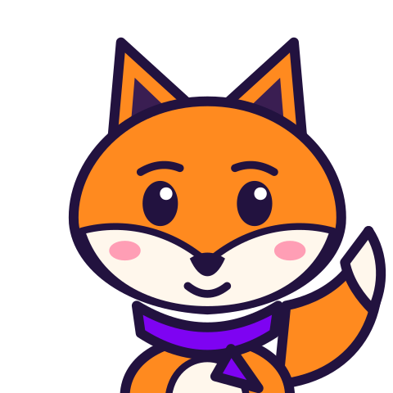
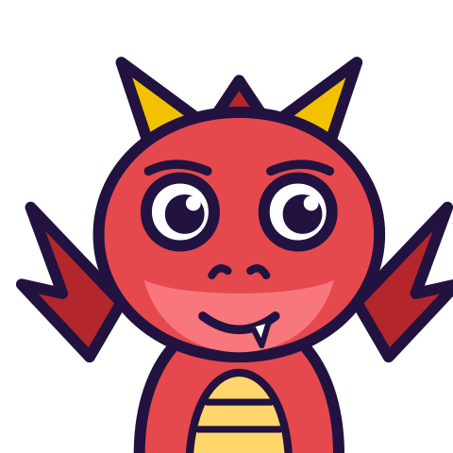

MATH WITH MR DJ
GRADE 7 · STATISTICS & PROBABILITY
PROBABILITY FROM EXPERIMENTAL DATA
Today's goal: I can predict the approximate relative frequency given the probability and understand that more trials of a chance experiment will increase the accuracy of the probability estimate.
Tan
Digit
Blaze
Pi
Notes:
[0:00] Frame it: theory predicts, experiment observes, and they agree only approximately.

Slide 2

WARM-UP
Turn & talk · 1 min
A spinner: 3 red sectors out of 10
1
Spun 20 times. Red comes up 8 times.
TURN & TALK
is the spinner unfair?
Math With Mr DJ · mathwithmrdj.com · 2/11
Notes:
[1:00] Hook — poll fair or unfair. Do NOT resolve. A gap of 0.10 looks damning until you see 500 spins.

Slide 3

BIG IDEA 1
Write it down
Relative frequency = hits ÷ trials
1
⁸⁄₂₀ = 0.40. Theory says 0.30.
2
A gap of 0.10 after 20 spins.
Math With Mr DJ · mathwithmrdj.com · 3/11
Notes:
[2:30] Define relative frequency and compute the first gap.

Slide 4

BIG IDEA 2
Now keep spinning
1
100 spins → 34 red → 0.34. Gap 0.04.
2
500 spins → 158 red → 0.316. Gap 0.016.
REMEMBER
The gap shrinks. The spinner never changed.
Math With Mr DJ · mathwithmrdj.com · 4/11
Notes:
[4:30] WE1 — the shrinking gaps. Write all three side by side: 0.100, 0.040, 0.016.

Slide 5
BIG IDEA 3
Predicting a count
1
Predicted reds in 200 spins = ₃⁄₁₀ × 200 = 60.
2
Say “about 60”. Exactly 60 is likely, but not expected.
Math With Mr DJ · mathwithmrdj.com · 5/11
Notes:
[7:00] WE2 — predicting a count, and the honest wording ‘about 60’.

Slide 6
BIG IDEA 4
The spinner has no memory
1
99 spins, no red. Is red “due”? No — still ₃⁄₁₀.
2
Results even out by DILUTION over many trials, not by changing odds.
REMEMBER
More trials improve the ESTIMATE. Never the next outcome.
Math With Mr DJ · mathwithmrdj.com · 6/11
Notes:
[10:30] The gambler's fallacy, plus the sharper point: a long run with no reds is evidence against the MODEL, not for red being due.

Slide 7
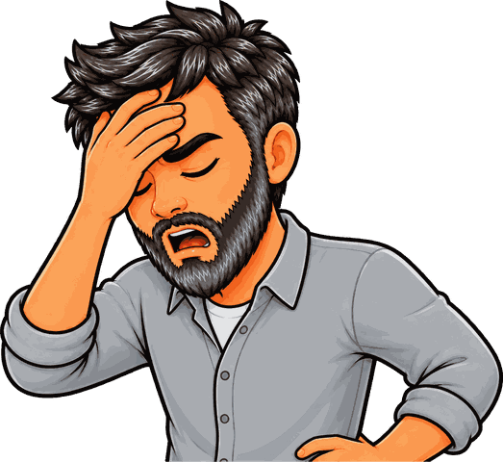
SPOT THE SLIP!
Turn & talk
Something went wrong here…
THE PROBLEM
How many would you predict in 1000 spins?
WHAT A STUDENT DID
Answered 30.
YOUR MISSION
What went wrong? What’s the right answer?
Math With Mr DJ · mathwithmrdj.com · 7/11
Notes:
Show the problem and the slip. Pairs: what went wrong, and what is the right answer? Take two answers before moving on.

Slide 8
WATCH MR DJ SOLVE
Copy the steps
How many would you predict in 1000 spins?
1
₃⁄₁₀ of 1000 = 300.
Answer:
300 reds
Math With Mr DJ · mathwithmrdj.com · 8/11
Notes:
Solve it together, one step at a time. It is also the worked example at the top of the practice sheet, so students can look back at it.

Slide 9
YOUR TURN
Whiteboards up!
Pick your pepper!
MILD
MEDIUM
SPICY
20 spins give 6 reds. Find the relative frequency.
How far is that from ₃⁄₁₀?
How does that compare with the theoretical ₃⁄₁₀? Does an exact match prove the spinner is fair?
#1 on your practice sheet
#3 on your practice sheet
#6 on your practice sheet
Math With Mr DJ · mathwithmrdj.com · 9/11
Notes:
[9:00] CFU — all-student response. 0.24, a gap of 0.06. Watch for counts instead of frequencies. Whiteboards: everyone tries Mild, then climbs. These are #1, #3, #6 on the practice sheet.

Slide 10


QUICK CHECK-IN
Show me your fingers
How’s it going?
3 · Got it!
2 · Almost
1 · Not yet
I could teach it
One more example, please
I need some help
Math With Mr DJ · mathwithmrdj.com · 10/11
Notes:
Fingers up: 3 = got it, 2 = almost, 1 = not yet. Pull the 1s for a quick reteach while everyone else starts the practice sheet.

Slide 11

MATH WITH MR DJ
NOW YOU!
Practice sheet: everyone does Mild & Medium, then climb the peppers.
Stuck? Look back at Mr DJ’s example at the top of the sheet.
Need it again? Step-by-step videos on YouTube @MathWithMrDJ
Brain break: 3 new daily puzzles at puzzles.mathwithmrdj.com
Notes:
[13:30] Launch the in-class practice sheet. Launch the practice sheet. Exit ticket in the last 5–8 minutes.

