Slide 1




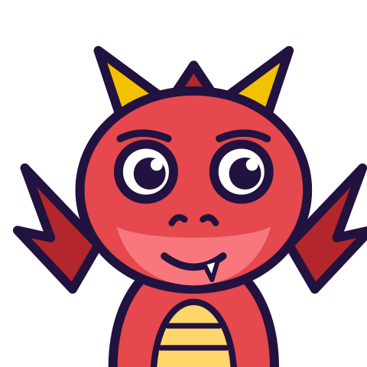

MATH WITH MR DJ
GRADE 7 · GEOMETRY
SURFACE AREA OF PRISMS
Today's goal: I can determine the surface area of three-dimensional prisms in mathematical problems and determine the surface area of three-dimensional prisms in real-world problems.
Tan
Digit
Blaze
Pi
Notes:
[0:00] Frame it: surface area is a covering question, so unfolding turns it into areas you already know.

Slide 2

WARM-UP
Turn & talk · 1 min
A triangular prism
1
Two triangular ends, base 6 and height 4. Length 10. Sides 5, 5, 6.
TURN & TALK
how many faces does it have?
Math With Mr DJ · mathwithmrdj.com · 2/11
Notes:
[1:00] Hook — poll the number of faces. Do NOT resolve. Six is the reflex answer after the “Nets and surface area” sheet (Grade 6).

Slide 3

WATCH OUT!
Five, not six
1
Two triangular ends + three rectangles = 5 faces.
2
Faces = (sides of the base) + 2.
DON’T FALL FOR IT
“A prism has six faces” is true only for a rectangular base.
Math With Mr DJ · mathwithmrdj.com · 3/11
Notes:
[2:30] WE1 — count them together, then give the sides-plus-two rule and test it on a box.

Slide 4

BIG IDEA 2
Add them up: 184
1
Ends: 2 × 12 = 24.
2
Rectangles: 10 × (5 + 5 + 6) = 160.
3
Total 184 square units.
Math With Mr DJ · mathwithmrdj.com · 4/11
Notes:
[5:00] Total it face by face. Insist the two ends are halved.

Slide 5
BIG IDEA 3
One formula for ALL prisms
1
SA = 2B + Ph
2
Two bases, plus the band wrapped around the outside.
REMEMBER
Unroll the band: it's one rectangle, P long and h tall.
Math With Mr DJ · mathwithmrdj.com · 5/11
Notes:
[7:00] WE2 — unroll an actual paper prism if you have one. The band becoming a rectangle is the whole derivation.

Slide 6
BIG IDEA 4
Covering or filling?
1
Wrapping the outside → SURFACE AREA → square units.
2
Filling the inside → VOLUME → cubic units.
REMEMBER
Exactly half the right surface area? Three faces were counted.
Math With Mr DJ · mathwithmrdj.com · 6/11
Notes:
[11:30] Covering versus filling, with the halved-answer fingerprint. Both are portable beyond this lesson.

Slide 7

SPOT THE SLIP!
Turn & talk
Something went wrong here…
THE PROBLEM
Find the volume of that cube.
WHAT A STUDENT DID
Answered 96, the surface area.
YOUR MISSION
What went wrong? What’s the right answer?
Math With Mr DJ · mathwithmrdj.com · 7/11
Notes:
Show the problem and the slip. Pairs: what went wrong, and what is the right answer? Take two answers before moving on.

Slide 8
WATCH MR DJ SOLVE
Copy the steps
Find the volume of that cube.
1
4 × 4 × 4 = 64 cubic units.
Answer:
64 cubic units
Math With Mr DJ · mathwithmrdj.com · 8/11
Notes:
Solve it together, one step at a time. It is also the worked example at the top of the practice sheet, so students can look back at it.

Slide 9
YOUR TURN
Whiteboards up!
Pick your pepper!
MILD
MEDIUM
SPICY
Find the surface area of a box 6 by 3 by 2.
Find the surface area of a cube with edge 4.
How many faces does that prism have? List them.
#1 on your practice sheet
#3 on your practice sheet
#6 on your practice sheet
Math With Mr DJ · mathwithmrdj.com · 9/11
Notes:
[9:30] CFU — all-student response. 94 square units both ways. Two methods agreeing is the strongest check available. Whiteboards: everyone tries Mild, then climbs. These are #1, #3, #6 on the practice sheet.

Slide 10


QUICK CHECK-IN
Show me your fingers
How’s it going?
3 · Got it!
2 · Almost
1 · Not yet
I could teach it
One more example, please
I need some help
Math With Mr DJ · mathwithmrdj.com · 10/11
Notes:
Fingers up: 3 = got it, 2 = almost, 1 = not yet. Pull the 1s for a quick reteach while everyone else starts the practice sheet.

Slide 11

MATH WITH MR DJ
NOW YOU!
Practice sheet: everyone does Mild & Medium, then climb the peppers.
Stuck? Look back at Mr DJ’s example at the top of the sheet.
Need it again? Watch “Surface Area of Prisms — Step by Step Guide” on YouTube @MathWithMrDJ
Brain break: 3 new daily puzzles at puzzles.mathwithmrdj.com
Notes:
[13:30] Launch the in-class practice sheet. This closes G7 Geometry. Launch the practice sheet. Exit ticket in the last 5–8 minutes.

