Slide 1






MATH WITH MR DJ
GRADE 8 · FUNCTIONS
WHAT A FUNCTION IS
Today's goal: I can understand that a function is a rule that assigns to each input exactly one output.
Tan
Digit
Blaze
Pi
Notes:
[0:00] Name both misreadings up front. Nearly every wrong answer on this topic is one of the two, and hearing them early makes them recognisable.

Slide 2

WARM-UP
Turn & talk · 1 min
The definition
1
Each INPUT gets exactly ONE output.
2
Put 3 in, and you always get the same thing out.
TURN & TALK
Nothing about formulas. Nothing about lines.
Math With Mr DJ · mathwithmrdj.com · 2/12
Notes:
[1:00] State the definition and say what is NOT in it: no formula, no line, no pattern. Children import all three.

Slide 3

WATCH OUT!
Not a function
1
(1,3) (2,5) (2,8) (3,7)
2
Input 2 gives 5 AND 8.
DON’T FALL FOR IT
One input, two answers. That is the only way to fail.
Math With Mr DJ · mathwithmrdj.com · 3/12
Notes:
[2:00] The only failure mode, concretely. One input with two outputs. Write the pairs and circle the repeated input.

Slide 4

BIG IDEA 1
Write it down
Read it the RIGHT way round
1
Each input → one output. ✓
2
Each output → one input. ✗ different rule.
REMEMBER
y = x²: both 2 and −2 give 4. Still a function.
Math With Mr DJ · mathwithmrdj.com · 4/12
Notes:
[3:00] THE slide. Say both sentences aloud, back to back, and let the class hear how similar they sound. Then y = x²: two inputs share an output and it is still a function, which is the case the backwards reading gets wrong.

Slide 5

BIG IDEA 2
Repeated OUTPUTS are fine
1
(1,5) (2,5) (3,5) is a function.
2
Every input has one output. It is always 5.
Math With Mr DJ · mathwithmrdj.com · 5/12
Notes:
[4:30] A constant function. Children resist this one because it feels like nothing is happening — but every input has exactly one output, which is the whole test.

Slide 6
BIG IDEA 3
No formula needed
1
A table can be a function.
2
So can a graph, or a list of pairs.
REMEMBER
“Find the rule” is a different question.
Math With Mr DJ · mathwithmrdj.com · 6/12
Notes:
[5:30] No formula required. Worth being explicit: “find the rule” has been the question for six years and it is not the question here.

Slide 7
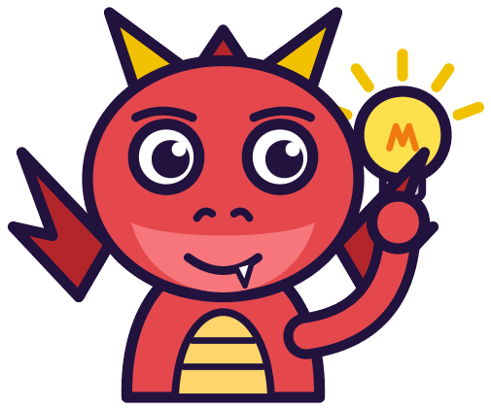
BIG IDEA 4
The vertical line test
1
Slide a VERTICAL line across the graph.
2
Two crossings at once → not a function.
REMEMBER
Vertical, because it asks about one INPUT.
Math With Mr DJ · mathwithmrdj.com · 7/12
Notes:
[6:30] The vertical line test as a PICTURE of the definition, not a separate fact. Ask why vertical before telling them — a child who can answer that has the definition.

Slide 8

SPOT THE SLIP!
Turn & talk
Digit found a slip…
THE PROBLEM
Is this a function? (2,7) (3,7) (4,7)
WHAT A STUDENT DID
Said no because the outputs repeat. This is the backwards reading in its simplest form.
YOUR MISSION
What went wrong? What’s the right answer?
Math With Mr DJ · mathwithmrdj.com · 8/12
Notes:
Show the problem and the slip. Pairs: what went wrong, and what is the right answer? Take two answers before moving on.

Slide 9

WATCH MR DJ SOLVE
Copy the steps
Is this a function? (2,7) (3,7) (4,7)
1
Inputs 2, 3, 4 each appear once.
2
The output being 7 every time is irrelevant — repeated outputs are allowed.
Answer:
yes
Math With Mr DJ · mathwithmrdj.com · 9/12
Notes:
Solve it together, one step at a time. It is also the worked example at the top of the practice sheet, so students can look back at it.

Slide 10
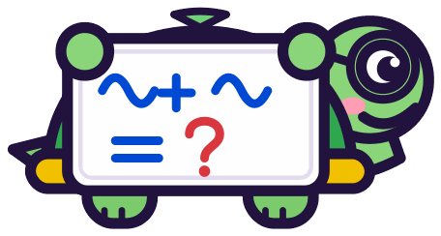
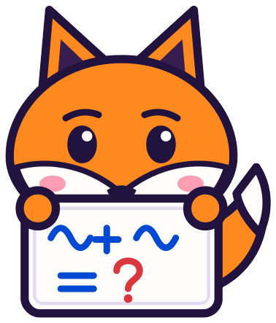
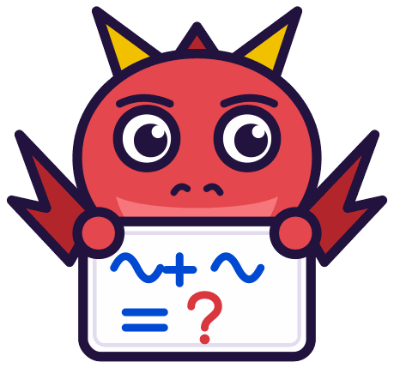
YOUR TURN
Whiteboards up!
Pick your pepper!
MILD
MEDIUM
SPICY
Is this a function? (5,1) (6,2) (5,9)
Is y = x³ a function? What about a circle?
Write the definition of a function in your own words.
#1 on your practice sheet
#2 on your practice sheet
#5 on your practice sheet
Math With Mr DJ · mathwithmrdj.com · 10/12
Notes:
[8:00] Three to sort, then the exit ticket. The circle is the one to discuss. Whiteboards: everyone tries Mild, then climbs. These are #1, #2, #5 on the practice sheet.

Slide 11



QUICK CHECK-IN
Show me your fingers
How’s it going?
3 · Got it!
2 · Almost
1 · Not yet
I could teach it
One more example, please
I need some help
Math With Mr DJ · mathwithmrdj.com · 11/12
Notes:
Fingers up: 3 = got it, 2 = almost, 1 = not yet. Pull the 1s for a quick reteach while everyone else starts the practice sheet.

Slide 12


MATH WITH MR DJ
NOW YOU!
Practice sheet: everyone does Mild & Medium, then climb the peppers.
Stuck? Look back at Mr DJ’s example at the top of the sheet.
Need it again? Step-by-step videos on YouTube @MathWithMrDJ
Brain break: 3 new daily puzzles at puzzles.mathwithmrdj.com
Notes:
Launch the practice sheet. Exit ticket in the last 5–8 minutes.

